Slide 1

Enhancing Gym Business Sustainability: Overcoming Challenges and Boosting Customer Engagement

Slide 2
Contents
About Organization
Meta Data
Data Analysis Process
Key Findings
Customer’s Feedback
Expenditure
Suggestions

Slide 3

About the Organization
Mr. Amit Chaudhary, owner of Muscle Factor Gym, Established a gym business to address inadequate gym facilities in the nearby area.
Many people came to the gym at first because it was close by and easy to get to, most of them were college students.
In the latter months, the number of active customers started to decline.
The revenue of the gym declined drastically.

Slide 4
Meta Data
Customers Data
Package Renewal
Expenditure

Slide 5
Data Analysis Process
Data Collection
1
Segmenting the Data
2
Removing Missing Values
3
Eliminating Redundant Data
4
Validating the Data
5
Creating Necessary Subsets for Analysis
6
Data Visualisation
7
Hypothesis Testing
8

Slide 6
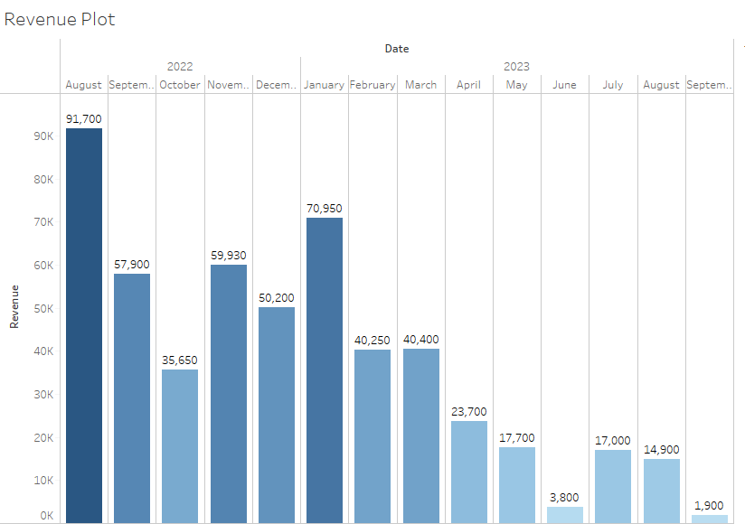
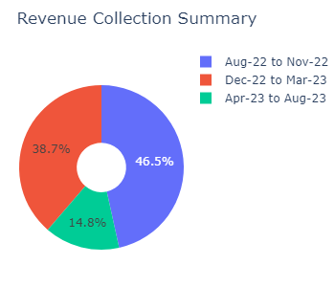
Key Findings

Slide 7
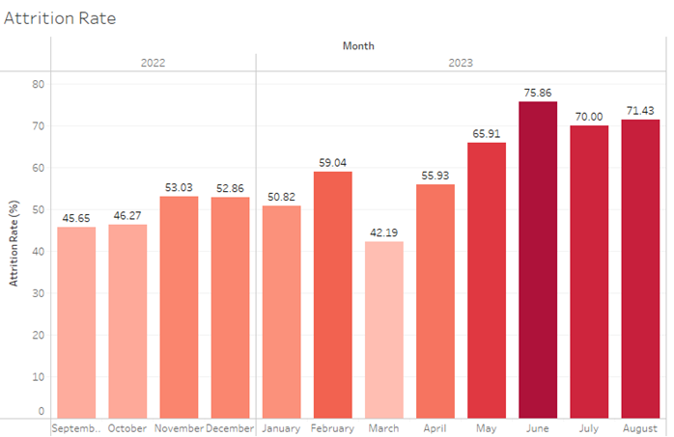
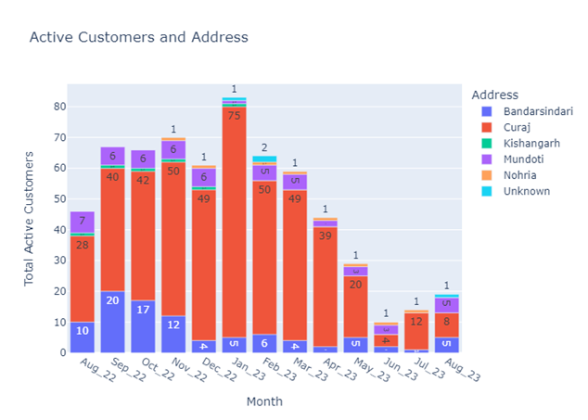
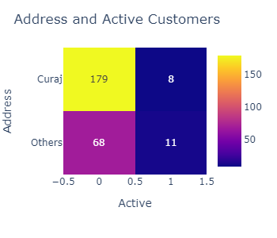
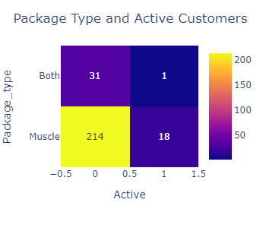

Slide 8
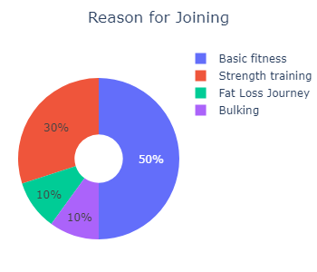
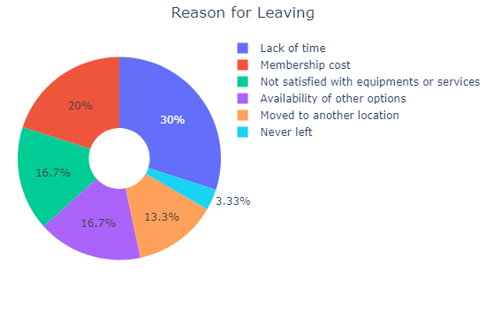
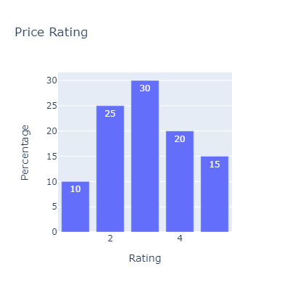
Customers Feedback
Other lacking facilities:
Lack of heavy dumbbells
Some Machines
Changing room
Unavailability of Electricity

Slide 9
Expenditure
Total Revenue Collection: ₹521780.0
Total Expenditure: ₹22,59,300.00
Deficit: ₹1737520
Purpose | Amount
Equipment and Accessory | ₹ 15,00,000.00
Infrastructure | ₹ 5,00,000.00
August-April | ₹ 2,34,900.00
May-August | ₹ 24,400.00
Total | ₹ 22,59,300.00

Slide 10
Suggestion
Revising the pricing strategy
offering a complimentary one-week personal training session
filling of vacant trainer positions
Addressing identified issues with the university gym
Investing in essential amenities
Fostering community and motivation through gym competitions
Diversify the customer base
Enhancing communication with customers

